Slide 1
THE SENSOR SYSTEM AND WIRELESS COMMUNICATION SECUIRTY OVER TOPOLOGY
BY: AYUSHI, LAKSHITA,HARSHITA
DEPARTMENT OF COMPUTER SCIENCE AND ELECTRONICS,
JAYOTI VIDHYAPEETH WOMEN’S UNIVERSITY,JAIPUR

Slide 2
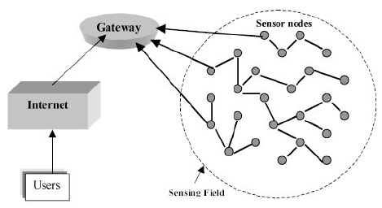
SENSOR SYSTEM
A SENSOR IS A DEVICE THAT DETECTS AND RESPONDS TO SOME TYPE OF INPUT FROM THE PHYSICAL ENIVORMENT
THE SPECIFIC INPUT COULD BR LIGHT ,HEAT,MOTION,MOISTURE,PRESSURE,OR ANY ONE OF A GREAT NUMBER OF OTHER ENIVORNMENTAL PHENOMENA.
THE OUTPUT IS GENERALLY A SIGNAL THAT IS CONVERTED TO HUMAN –READABLE DISPLAY AT THE SENSOR LOCATION OR TRANSIMITTED ELECTRONICALLY OVER A NETWORK FOR READINGFURTHER PROCROSSING

Slide 3
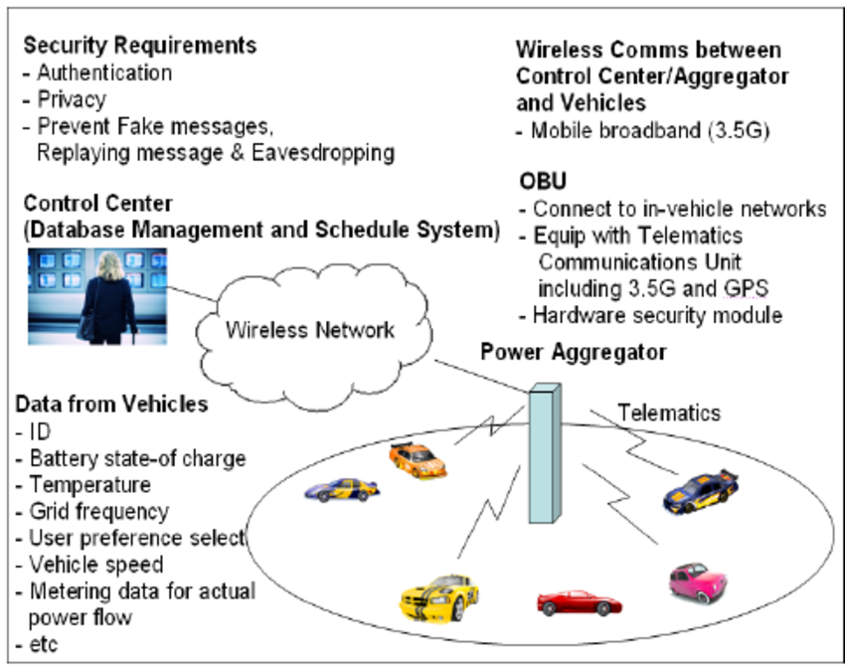
WIRELESS COMMUNICATION SECURITY
IT IS THE PREVENTION OF UNAUTHORIZED ACCESS OR DAMAGE TO COMPUTERS OR DATA USING WIRELESS NETWORKS.
THE MOST COMMON TYPES OF WIRELESS SECUIRTY ARE :
WIRED EQUIVALENT PRIVACY(WPA)
THE CURRENT STANDARD IS WPA2

Slide 4
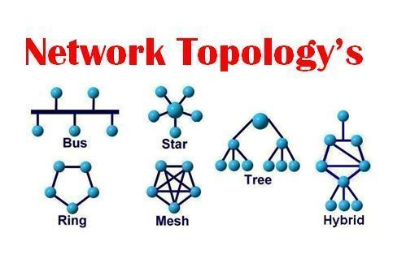
NETWORK TOPOLOGY
COMPUTERS IN A NETWORK HAVE TO BE CONNCECTED IN SOME LOGICAL MANNER ,THE LAYOUT PATTERN OF THE INTERCONNECTIONS BETWEEN COMPUTERS IN A NETWORK IS CALLED NETWORK TOPOLOGY.
YOU CAN THINK OF TOPOLOGY AS THE VIRTUAL SHAPE OR STRUCTURE OF THE NETWORK,IT IS ALSO REFERRED AS NETWORK ARCHITECTURE.
THE MOST COMMON NODES AND THERE PERIPERHAL DEVICES.NETWORK TOPLOGY IS ILLUSTRATED BY THESE NODES AND THEIR CONNECTIONS USING CABLES.
THERE ARE MANY TOPLOGY:
STAR,BUS,MESH,POINT TO POINT,HYBRID,RING,TREE

Slide 5
INTRODUCTION TO WIRELESS SENSOR NETWORK
A WIRELESS SENSOR NETWORK CAN BE DEFINED AS A NETWORK OF DEVICES THAT CAN COMMUNICATE THE INFORMATION GATHERED FROM A MONITORED FIELD THROUGH WIRELESS LINKS.
THE DATA IS FORWAREDED THROUGH MULTIPLE NODES AND WITH A GATEWAY,THE DATA IS CONNECTED TO OTHER NETWORKS LIKE WIRELESS ETHERNET.
WSN CONSISTS OF NODES(WIRELESS SENSOR) THESE NETWORKS ARE USED TO MONITOR PHYSICAL OR ENVIRONMENTAL CONDITIONS LIKE SOUND,PRESSURE,TEMPERATURE AND CO OPERATIVELY PASS DATA THROUGH THE NETWORK TO A MAIN LOCATION .

Slide 6
TYPES OF WSNS(WIRELESS SENSOR NETWORK SYSTEM)
DEPENDING ON THE ENIVORNMENT ,THE TYPES OF NETWORKS ARE DECIDED SO THAT THOSE CAN BE DEPLOYED UNDERWATER ,UNDERGROUND,ON THE LAND,AND SO ON .
DIFFERENT TYPES OF WSNS INCLUDES:
1. TERRESTIAL WSN S
2. UNDERGROUND WSN S
3. UNDERWATER WSN S
4. MOBILE WSN S
5. MULTIMEDIA WSN S

Slide 7
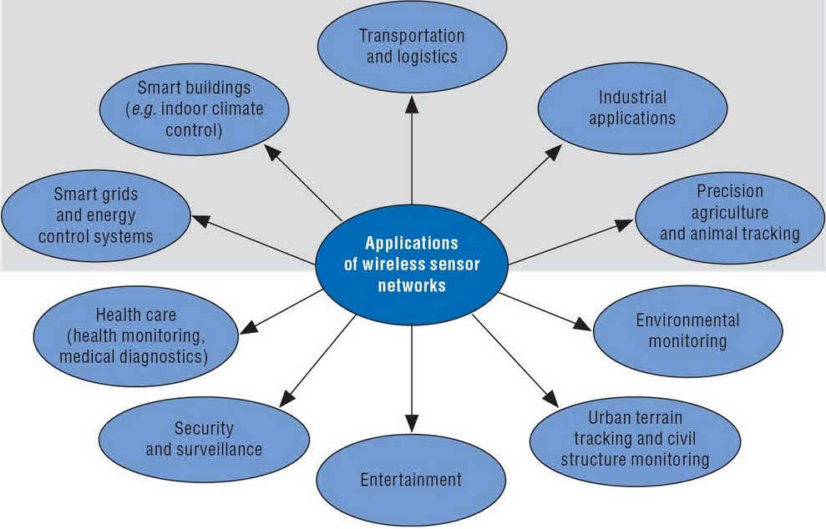
APPLICATIONS

Slide 8
LIMITATIONS OF WIRELESS SENSOR NETWROKS
Possess very little storage capacity – a few hundred kilobytes
Possess modest processing power-8MHz
Works in short communication range – consumes a lot of power
Requires minimal energy – constrains protocols
Have batteries with a finite life time
Passive devices provide little energy

Slide 9
CONCLUSION
WSN S PROVIDE EXECELLENT INFORMATION INFRASTRUCTURE FOR THE REMOTE MONITORING TRACKING AND CONTROL OF INDOOR AND OUTDOOR ENVIRONMENTS, INDUSTRIAL PLANTS AND OTHER APPLICATIONS HOWEVER MANY DESIGN AND IMPLEMENTATION ISSUES STILL NEED TO BE FULLY ADDRESSED SUCH AS SENSOR NODE HARDWARE DESIGN ,INTERFERACE MITIGRATION ,SECURITY ,DATA FUSION,ETC.
IT IS HARD TO FIND A GENERIC SOLUTION FOR SOMNE OF THESE PARTICULAR ISSUES THEREFORE APPLICATION SPECIFIC SOLUTIONS HAVE TO BE PROVIDED.

Slide 10


